Slide 1
Chapter – 17 software quality

Slide 2
Outline of the Chapter
Five Views of Software Quality
McCall’s Quality Factors and Criteria
The ISO 9126 Quality Characteristics
Summary

Slide 3
Five Views of Software Quality
Transcendental view
User view
Manufacturing view
Product view
Value-based view

Slide 4
Five Views of Software Quality
Transcendental view
Quality is something that can be recognized through experience, but not defined in some tractable form.
A good quality object stands out, and it is easily recognized.
User view
Quality concerns the extent to which a product meets user needs and expectations.
Is a product fit for use?
This view is highly personalized.
A product is of good quality if it satisfies a large number of users.
It is useful to identify the product attributes which the users consider to be important.
This view may encompass many subject elements, such as usability, reliability, and efficiency.

Slide 5
Five Views of Software Quality
Manufacturing view
This view has its genesis in the manufacturing industry – auto and electronics.
Key idea: Does a product satisfy the requirements?
Any deviation from the requirements is seen as reducing the quality of the product.
The concept of process plays a key role.
Products are manufactured “right the first time” so that the cost is reduced
Development cost
Maintenance cost
Conformance to requirements leads to uniformity in products.
Some argue that such uniformity does not guarantee quality.
Product quality can be incrementally improved by improving the process.
The CMM and ISO 9001 models are based on the manufacturing view.

Slide 6
Five Views of Software Quality
Product view
Hypothesis: If a product is manufactured with good internal properties, then it will have good external properties.
One can explore the causal relationship between internal properties and external qualities.
Example: Modularity enables testability.
Value-based view
This represents the merger of two concepts: excellence and worth.
Quality is a measure of excellence, and value is a measure of worth.
Central idea
How much a customer is willing to pay for a certain level of quality.
Quality is meaningless if a product does not make economic sense.
The value-based view makes a trade-off between cost and quality.

Slide 7
Five Views of Software Quality
Measuring quality
Reasons for developing a quantitative view of quality
Measurement of user’s view
Measurement of manufacturing view
Reasons for developing a quantitative view of quality
Measurement allows us to establish baselines for qualities.
Measurement is key to process improvement.
The needs for improvements can be investigated after performing measurements.

Slide 8
Five Views of Software Quality
Measurement of user’s view
Functionalities can be easily measured.
What functionality test cases have passed?
Measure of delivered functionality = ratio of # of passed test cases to the total number of test cases designed to verify the functionalities.
Apply Gilb’s technique.
The quality concept is broken down into component parts until each can be stated in terms of directly measurable qualities.
Example: Usability can be broken down into
Learnability
Understandability
Operability

Slide 9
Five Views of Software Quality
Measurement of manufacturer’s view
Manufacturers are interested in defect count and rework cost.
Defect count: The total number of defects detected during development and operation.
It is a measure of the quality of the work produced.
One can analyze the defects as follows.
For each defect, identify the development phase in which it was introduced.
Categorize the defects, say, based on modules.
Normalize defect count by product size.
Defect density: Number of defects per 1000 lines of code.
Separate the defects found during operation from those found during development.
Rework cost: How much does it cost to fix the known defects?
Development rework cost: This is the rework cost incurred before a product is released. This is a measure of development efficiency.
Operation rework cost: This is the rework cost incurred when a product is in operation. This is a measure of the delivered quality.

Slide 10
McCall’s Quality Factors and Criteria
Quality Factors
McCall, Richards, and Walters studied the concept of software quality in terms of two key concepts as follows:
quality factors, and
quality criteria.
A quality factor represents the behavioral characteristic of a system.
Examples: correctness, reliability, efficiency, testability, portability, …
A quality criterion is an attribute of a quality factor that is related to software development.
Example:
Modularity is an attribute of the architecture of a software system.
A highly modular software allows designers to put cohesive components in one module, thereby increasing the maintainability of the system.
McCall et al. identified 11 quality factors (Table 17.1.)

Slide 11
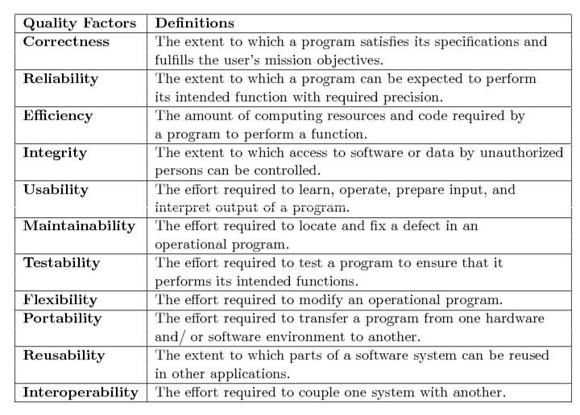
McCall’s Quality Factors and Criteria
Table 17.1: McCall’s quality factors [10].

Slide 12
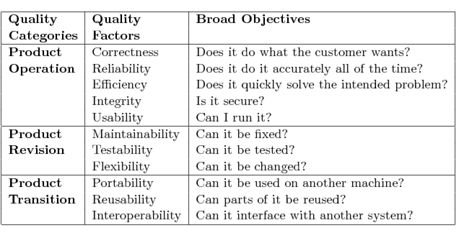
McCall’s Quality Factors and Criteria
The 11 quality factors defined in Table 17.1 have been grouped into three broad categories (See Table 17.2.)
Product operation
Product revision
Product transition
Table 17.2: Categorization of McCall’s quality factors [10].

Slide 13
McCall’s Quality Factors and Criteria
Quality Criteria
A quality criterion is an attribute of a quality factor that is related to software development.
Example:
Modularity is an attribute of the architecture of a software system.
A highly modular software allows designers to put cohesive components in one module, thereby increasing the maintainability of the system.
In Table 17.3, we have listed 23 quality criteria.

Slide 14
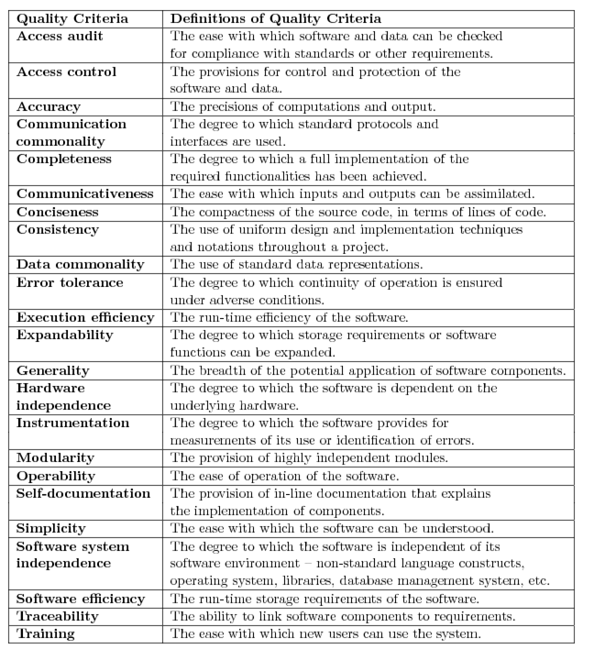
McCall’s Quality Factors and Criteria
Table 17.3: McCall’s quality
criteria [10].

Slide 15
McCall’s Quality Factors and Criteria
Relationship Between Quality Factors and Quality Criteria
Each quality factor is positively influenced by a set of quality criteria, and the same quality criterion impacts a number of quality factors.
Example: Simplicity impacts reliability, usability, and testability.
If an effort is made to improve one quality factor, another quality factor may be degraded.
Portable code may be less efficient.
Some quality factors positively impact others.
An effort to improve the correctness of a system will increase its reliability.
See Figure 17.1.

Slide 16
McCall’s Quality Factors and Criteria
Figure 17.1: Relation between quality factors and quality criteria [10].

Slide 17
The ISO 9126 Quality Characteristics
The ISO 9126 document is the product of an international effort.
ISO: International Organization for Standardization
The document defines six broad quality characteristics as shown in Table 17.4.
The document includes an example quality model (Figure 17.2) that further decomposes the quality characteristics.
Figure 17.2 is just an example, and not a universal one.
The 20 sub characteristics of Figure 17.2 have been defined in Table 17.5.

Slide 18
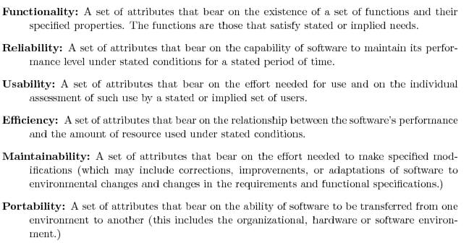
The ISO 9126 Quality Characteristics
Table 17.4: ISO 9126 quality characteristics.

Slide 19
The ISO 9126 Quality Characteristics
Figure 17.2: The ISO 9126 sample quality model refines the standard’s features into sub characteristics [9]. (©[1996] IEEE)

Slide 20
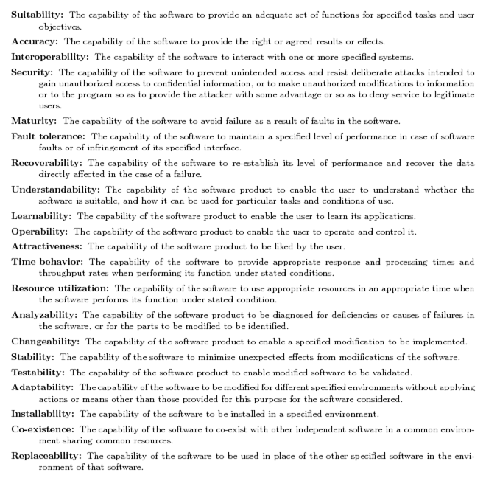
The ISO 9126 Quality Characteristics
Table 17.5: Quality subcharacteristics of ISO 9126.

Slide 21
The ISO 9126 Quality Characteristics
McCall’s quality model vs. ISO 9126 model
What is called quality factor in McCall’s model is called a quality subcharacteristic in the ISO 9126 model.
The following quality factors/characteristics are found in both the models.
reliability, usability, efficiency, maintainability, and portability
Differences between the two models
The ISO 9126 model emphasizes on characteristics visible to the users, whereas the McCall model considers internal qualities as well.
In McCall’s model, one quality criterion can impact many quality factors, whereas in the ISO 9126 model, one subcharacteristic impacts exactly one quality characteristic.
A high-level quality factor, such as testability, in the McCall’s model is a low-level subcharacteristic of maintainability in the ISO 9126 model.
Concerns
There is no consensus about what high-level quality factors are most important at the top level. McCall, et al. define 11 high-level quality factors, whereas there are only six in the ISO 9126 document.
There is no consensus regarding what is a top-level quality factor/ characteristic and what is a more concrete quality criterion/ subcharacteristic.

Slide 22
Thank You!!

